Slide 1
Modelling Smart FPGA Switches in the Network
Benji Levine
Supervised by Suhaib Fahmy
Notes:
Title different
Agile methodology
Revisions

Slide 2
What are FPGAs?
Field-Programmable Gate Array
Can be seen as alternative to ASIC
Flexible Logic -------------------------------------------
Flexible routing -----------------------------------------
Flexible IO -----------------------------------------------
Embedded hard modules ------------------------------
Application-Specific Integrated Circuit
LUTs
Large grid of wires and switch boxes
Support for 10G Ethernet, SATA, PCIe
Block memory, DSP blocks
Static
Flexible
Fast
Slow
ASIC
FPGA
CPU
(1)
Notes:
1:30
Flexible logic: basic configurable block to implement combinational logic, coupled with clocked elements to enable synchronous logic and pipelining
Flexible routing: significant chip area dedicated to wires and switch boxes that enable connections between all components
Flexible IO: multi-standard interfacing to external pins, with a range of speed capabilities
Embedded hard modules: an increasing number of different resources optimised for speed and area, including DSP functions and memories

Slide 3
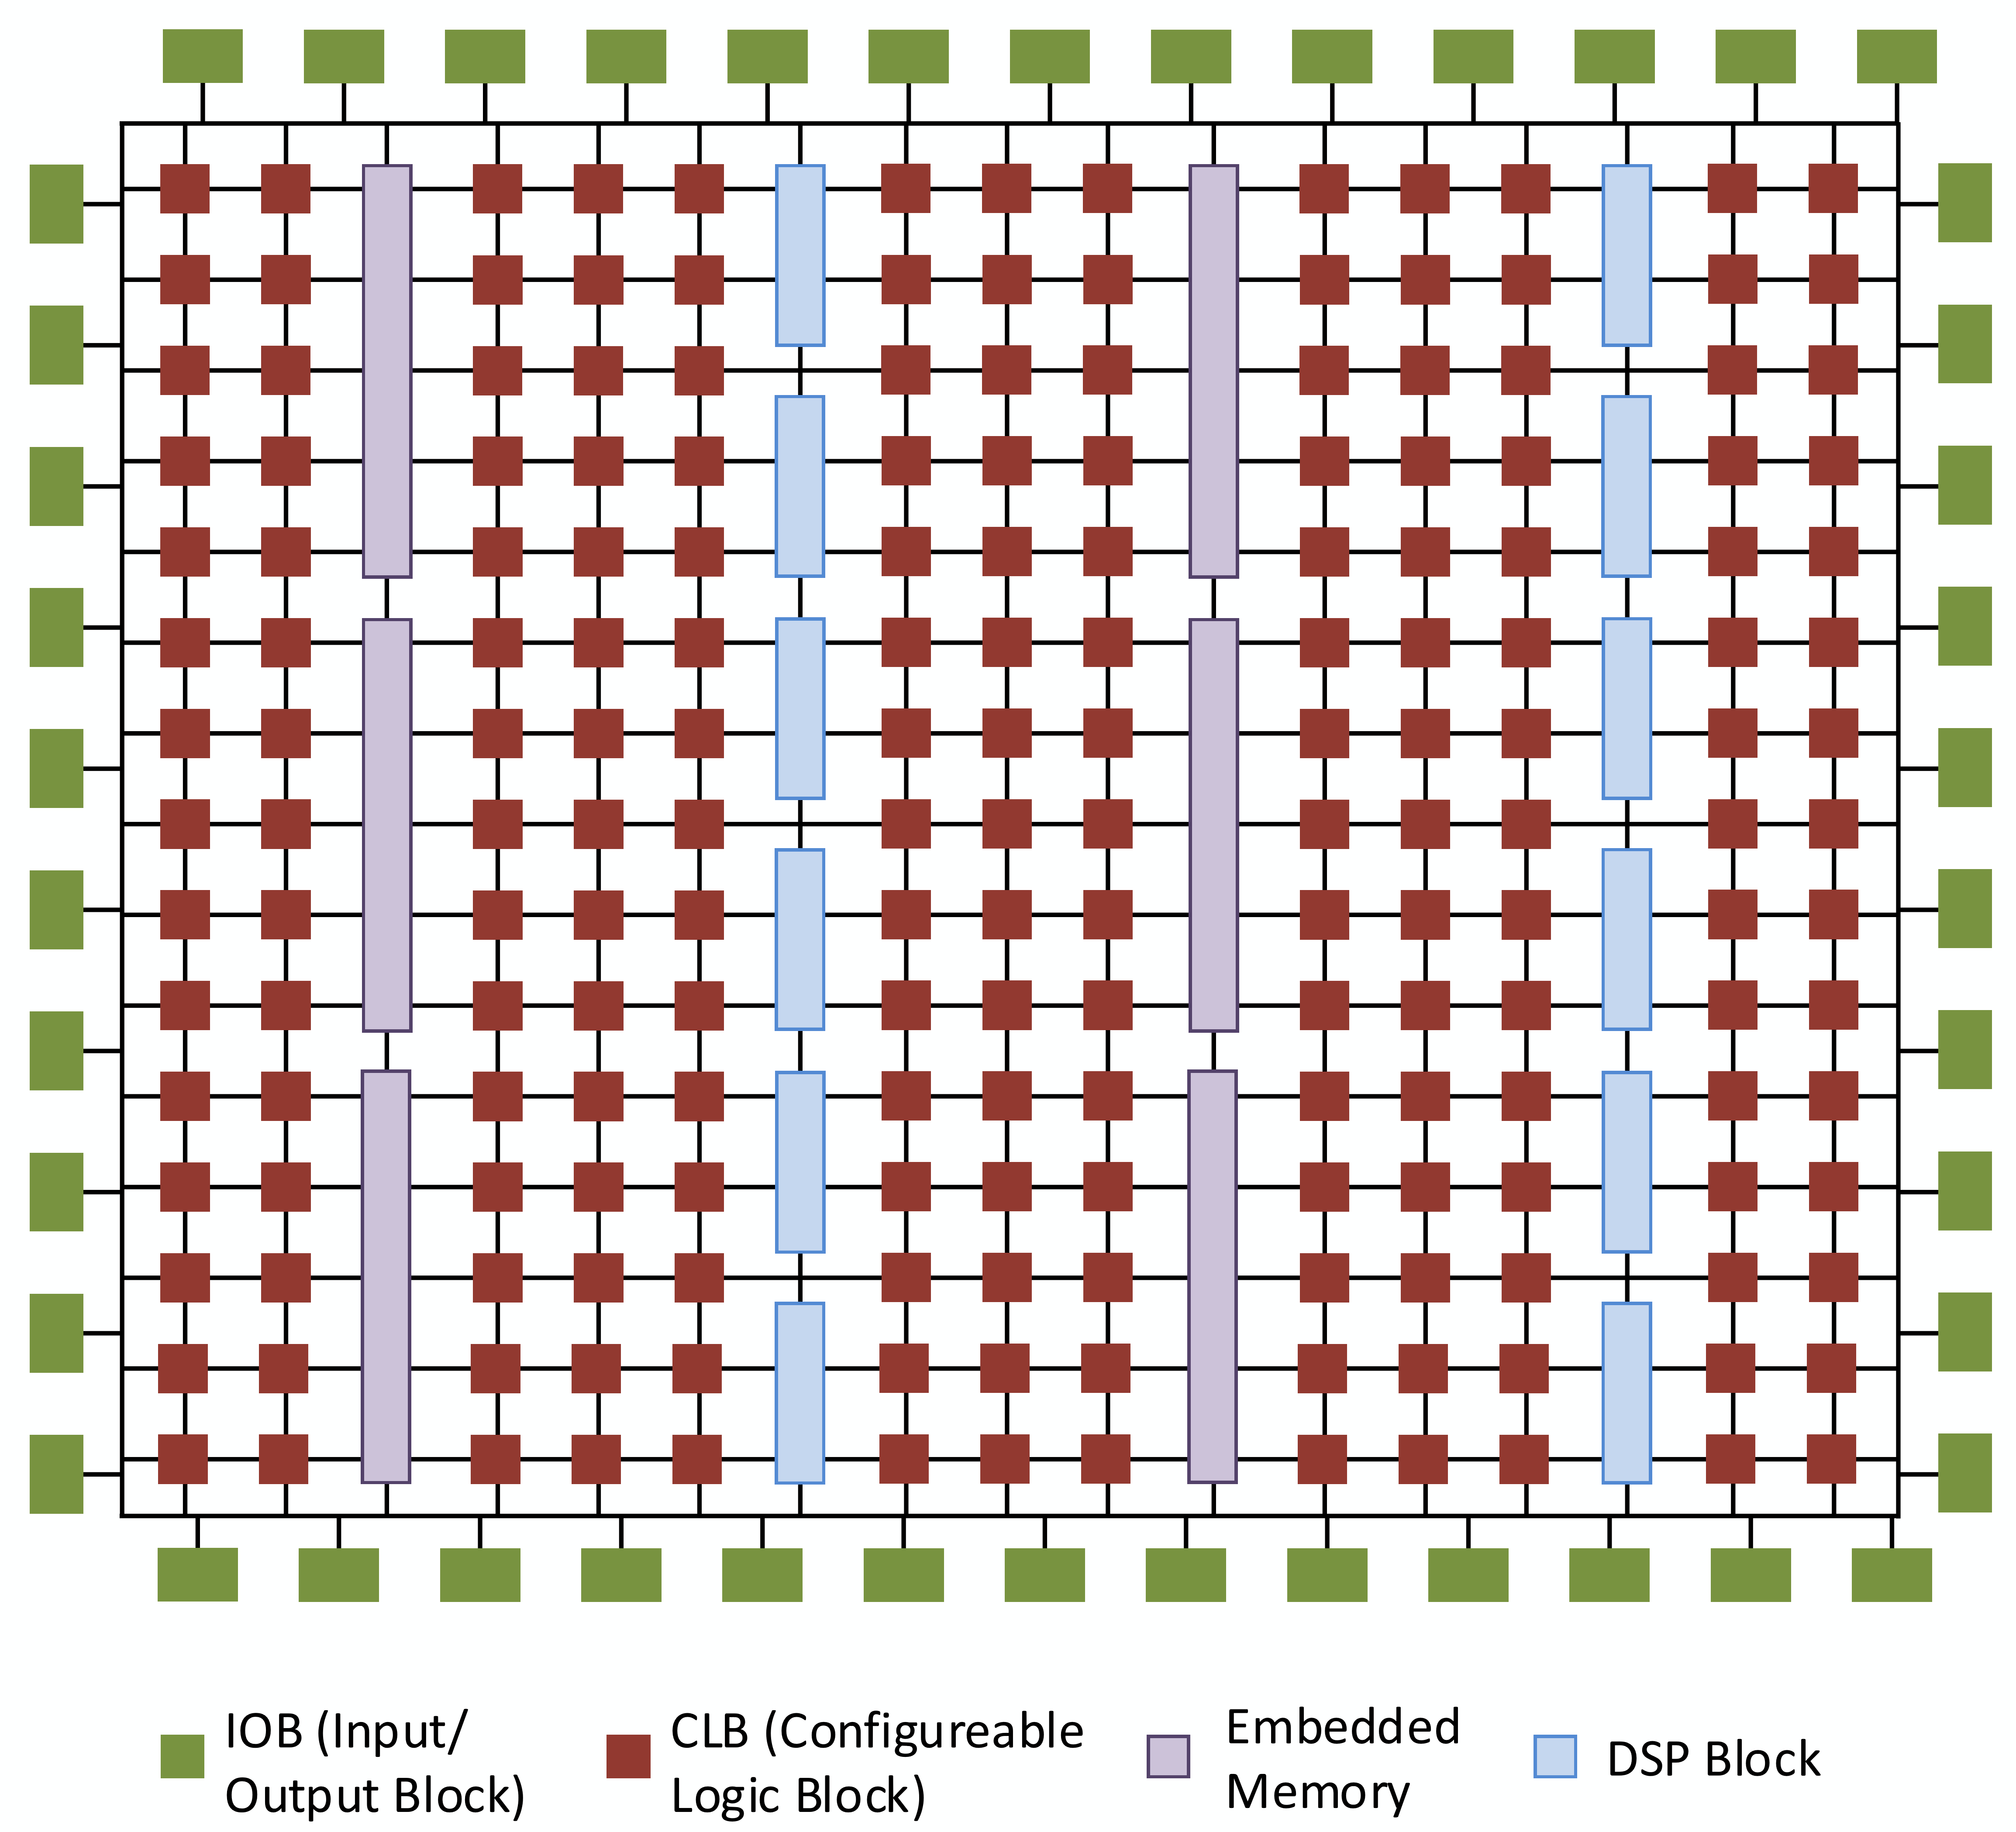
What are FPGAs?
Field-Programmable Gate Array
Seen as alternative to ASIC
Flexible Logic
Flexible routing
Flexible IO
Embedded hard modules
Application-Specific Integrated Circuit
LUTs
Large grid of wires and switch boxes
Support for 10G Ethernet, SATA, PCIe
Block memory, DSP blocks
(1)
Notes:
2:00
Flexible logic: basic configurable block to implement combinational logic, coupled with clocked elements to enable synchronous logic and pipelining
Flexible routing: significant chip area dedicated to wires and switch boxes that enable connections between all components
Flexible IO: multi-standard interfacing to external pins, with a range of speed capabilities
Embedded hard modules: an increasing number of different resources optimised for speed and area, including DSP functions and memories

Slide 4
Networking Concepts
OSI Network Model
TCP / IP network stack
Application
Presentation
Session
Transport
Internet
Network
Data Link
Link
Physical
Notes:
3:00

Slide 5
Networking Concepts
Control plane
Data plane
P4
OpenFlow (part of Mininet)
OSI Network Model
TCP / IP network stack
Application
Transport
Internet
Link
Software Defined Networking
Notes:
4:00
SDN separates the control plane from the data plane
Operates at the Internet / Network
Gives the programmer more direct and clear control over how routing decisions are made.
Separates the network control, known as the control plane, from the forwarding process, known as the data plane.
The control plane makes decisions about packets which are either destined to or originally from the current host, while the data plane makes decisions about packets which are going through the host.
The control plane also maintains the routing table, which is used by both planes to make routing decisions
P4 is a language for programming data plane. Sep 2014.

Slide 6
Why Smart FPGA Switches?
Cloud computing
High latencies
Large data centres
Amazon Web Services (AWS)
Microsoft Azure
Google Cloud Platform
Apache Hadoop
Notes:
5:30

Slide 7
Why Smart FPGA Switches?
Cloud computing
Existing solutions
“Edge” / “gateway” nodes
Mainframes
NetFPGA
Software Defined Networking (SDN)
Notes:
6:30

Slide 8
Why Smart FPGA Switches?
Cloud computing
Existing solutions
Drawbacks
Similar to data centres
Latency
Security
Scalability
Notes:
7:00

Slide 9
Why Smart FPGA Switches?
Cloud computing
Existing solutions
Drawbacks
Solution
Do not divert data from existing path
Appropriate device for computation
Static
Flexible
Fast
Slow
ASIC
FPGA
CPU
Notes:
8:00

Slide 10
Why Smart FPGA Switches?
Cloud computing
Existing solutions
Drawbacks
Solution
FPGAs
Custom compute architectures – very low latency
Partial reconfiguration
Specific hardware for each algorithm
Notes:
9:00

Slide 11
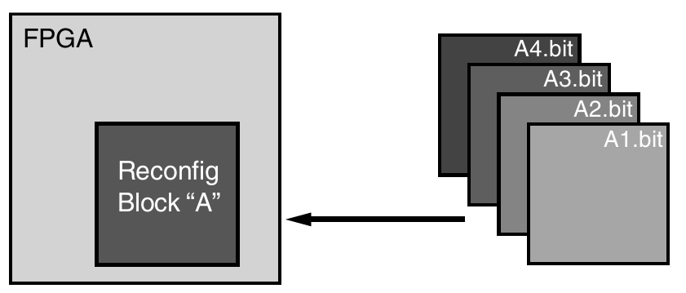
Why Smart FPGA Switches?
Cloud computing
Existing solutions
Drawbacks
Solution
FPGAs
Partial reconfiguration
Specific hardware for each algorithm
(2)
Notes:
10:00

Slide 12
Research and Implementation
Mininet
“Emulator for rapid prototyping of Software Defined Networks”
Open source
Python API
Scalable
Dependency chain
(3)
Notes:
11:00

Slide 13
Research and Implementation
Mininet
NetFPGA
PCI Express interface
Xilinx Virtex / Kintex
4 x 1Gbps – 10Gbps Ethernet
Open source software
1G, 10G, SUME, CML
Standalone or integrated
(4)
Notes:
12:00

Slide 14
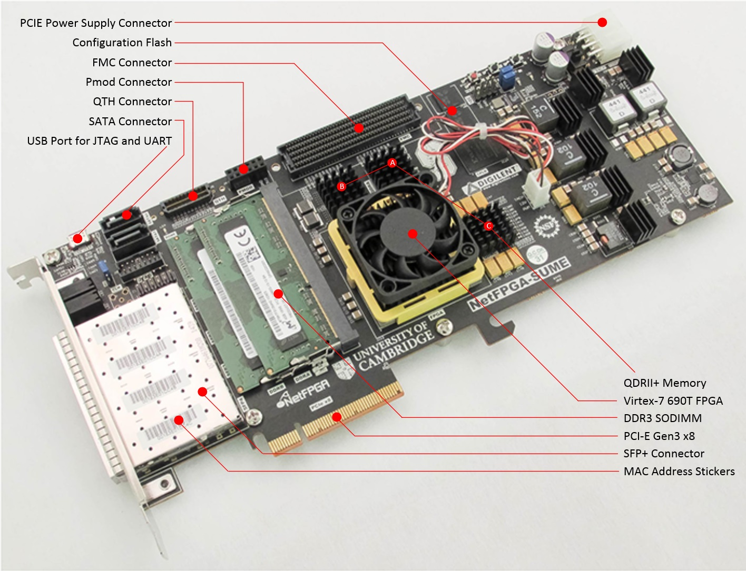
Research and Implementation
Mininet
NetFPGA
PCI Express interface
Xilinx Virtex / Kintex
4 x 1Gbps – 10Gbps Ethernet
Open source software
1G, 10G, SUME, CML
Standalone or integrated
(5)
Notes:
Just under 8GB/s
7.875GB/s

Slide 15
Research and Implementation
Mininet
NetFPGA
Software Development
Python
Open source (GitHub)
setuptools
click
logging
git submodules
(6), (7), (8), (9)
Notes:
13:00

Slide 16
Project Management
Agile methodology ---------------------------
Kanban Board --------------------------------
Version control --------------------------------
Weekly meetings with supervisor ----------
Issues resolved quickly -----------------------
Adaptive to change
Trello
git
Comparable to “scrums”
Access to tools, licensing
(10), (11)
Notes:
15:00

Slide 17
Applications
Internet of Things (IoT)
Education
Healthcare
Military
Finance
Notes:
16:00

Slide 18
Model Results
Operating Parameters:
Latency: 1ms
FPGA latency: 2ms
Spread: 1 (vertical linear topology)
Notes:
16:30

Slide 19
Model Results
Operating Parameters:
Latency: 1ms
FPGA latency: 2ms
Spread: 1 (vertical linear topology)
Notes:
17:30

Slide 20
Demo
Notes:
21:00

Slide 21
Questions
Notes:
25:00

Slide 22
References
ES3F1 Lectures, Suhaib Fahmy
xilinx.com
mininet.org
netfpga.org
reference.digilentinc.com
python.org
github.com
https://github.com/pypa/setuptools
https://palletsprojects.com/p/click/p4.org
trello.com
git-scm.com

